Slide 1


Studying Salmonella gene expression dynamics in response to novobiocin
Supervisor:
Aleksandr Tkachenko, ITMO University

Slide 2


Introduction
DNA supercoiling is very sensitive to various environmental conditions and is a sensor of various stress factors. The antibiotic novobiocin is an inhibitor of the ATPase domain of DNA gyrase; its action affects the global topology of cell DNA. To study the dynamics of changes in gene expression under the influence of novobiocin, weighted gene coexpression network analysis was used in this work.
Gene co-expression networks are increasingly used to explore the system-level functionality of genes. The network construction is conceptually straightforward: nodes represent genes and nodes are connected if the corresponding genes are significantly co-expressed across appropriately chosen tissue samples [1]. In this work, we studied the effect of an antibiotic that changes the degree of DNA helix, which triggers various intracellular processes [2], so the construction of gene coexpression networks makes biological sense.

Slide 3
The aim and objectives of the project
The aim of this work was to study the effect of novobiocin on gene expression in Salmonella enterica subsp. enterica serovar Typhimurium str. 14028S at various time points.
Project objectives:
1) align reads for the reference genome;
2) obtain a transcript count matrix;
3) carry out a primary analysis of the calculation matrix using the DESeq2 package;
4) carry out a weighted gene co-ecspression network analysis using the WGCNA package

Slide 4
Data description
The data of bacterial cultures with the addition of 100 µg, 500 µg of novobiocin, as well as control cultures were studied. Samples were taken from several time points: 0, 10, 20, 60 minutes for control samples; 10, 20, 60 minutes for samples treated with 500 µg of novobiocin; 60 minutes for samples treated with 100 µg of novobiocin. For each time point, 3 biological replicates were made. A total of 24 samples were made.
Data was taken from: https://www.sciencedirect.com/science/article/pii/S2352340920301918
All stages of sample preparation and obtaining libraries are described in the article. Cleaned reads for each sample are at the NCBI SRA. To access the data, we used the ENA Browser at the following link (project PRJNA599397): https://www.ebi.ac.uk/ena/browser/text-search?query=PRJNA599397

Slide 5
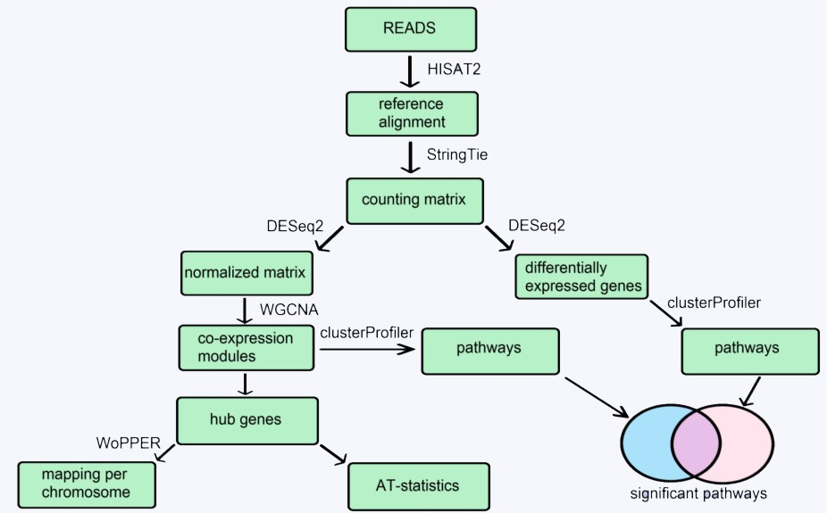
Methodology
Pipeline

Slide 6
Data preparation (1).
All samples were analyzed using FASTQC version 0.11.9
All samples were of good quality;
The adapter strings were not loaded;
There were minor issues with GC composition and per base sequence content for a number of samples;
After quality control, all samples were accepted for further processing;
At this stage, it was decided not to use samples treated with 100 µg of novobiocin for further study, since they were presented with one time point of 60 minutes and there were no others.
We also removed control samples with 0 time point. This was done to ensure that the time points were equal between the novobiocin treated group and controls.
Thus, for further processing, we used control samples at 10, 20, and 60 minutes and samples treated with novobiocin at 10, 20, and 60 minutes; A total of 18 samples were examined.

Slide 7

Data preparation (2).
Genome sequence of the Salmonella enterica subsp. enterica serovar Typhimurium strain 14028S assembly GCA_000022165.1 was used as a reference.
The genome sequence and annotation file are available at: (https://www.ncbi.nlm.nih.gov/nuccore/NC_016856.1 ).
HISAT2 version 2.1.0 was used to build index of reference genome and align clean reads to genome with the following parameters: hisat2 -p --dta -x -U –S.
SAM files of alignments created by HISAT2 were converted to BAM files using SAM-tools view.
Mapped reads were summarized at the transcript level into a count matrix using the assembler of RNA-Seq alignments StringTie version 2.2.0.
Converting the alignment results to a matrix of read counts mapped to particular genomic features was done using the python script provided in the StringTie tutorial (http://ccb.jhu.edu/software/stringtie/index.shtml?t=manual ).

Slide 8

DESeq2
DESeq2 version 1.34.0 was used to estimate the variance between groups of samples and repeated samples using principal component analysis (PCA), as well as to normalize the number of reads.
DESeq2 analysis was performed for Transcript_counts_matrix;
The creation of the DESeq object was done using the formula: ~ Treated+Time+Treated:Time;
Genes with log2FoldChange < 1.5 and FDR < 0.05 were considered significant;

Slide 9
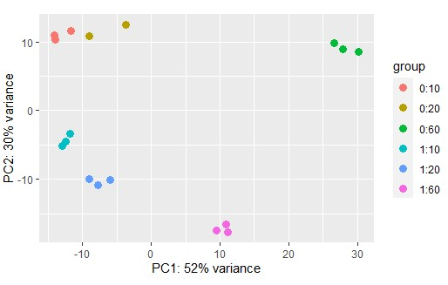
PCA for test samples
Group 0 - control, group 1 - treated with 500 μg of novobiocin. The second digit represents the time point: 10, 20, or 60 minutes. Each group corresponds to 3 biological repetitions. A total of 18 samples were studied. Biological replicas cluster best with each other; according to the first component, the samples are best separated in time; according to the second component, the samples are separated by the presence of novobiocin.

Slide 10
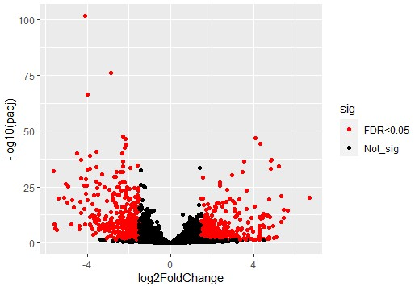
Volcano plot
Genes for which log2FoldChange<1.5 and FDR<0.05 were considered insignificant; a total of 789 significant genes were identified.
370 positive genes and 419 negative genes were found.

Slide 11
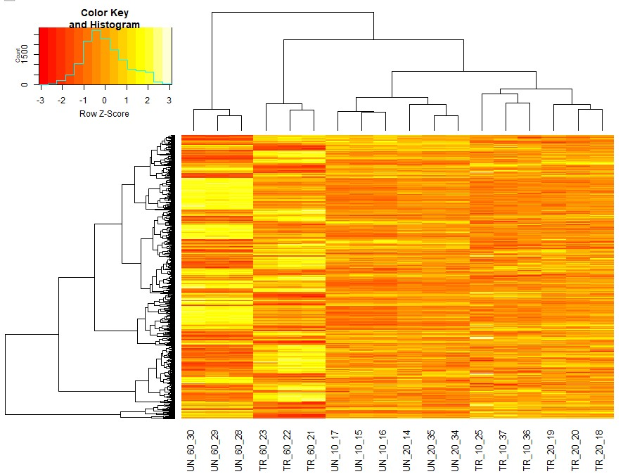
Heatmap for differentially expressed genes (DEGs)
A large number of differentially expressed genes does not give a clear idea of the nature of the changes under the action of an antibiotic.

Slide 12

WGCNA
The WGCNA version 1.70-3 package has been used;
Modules of co-expressed genes were built; topological matrix type was chosen "signed"; the power parameter was calculated using the pickSoftThreshold() function as the smallest one, at which the resulting network had a similarity index with the unscaled network of more than 0.8;
The relationship of modules with the time of cultivation and treatment with novobiocin was determined; Spearman's correlation coefficient was used for calculation;
Hierarchical clustering of modules was carried out;
The key genes (hub genes) for the modules associated with antibiotic treatment were determined by relationships with the module's own genes (the first major component for the genes included in the module). Genes were recognized as key for the module if the correlation with the module's own genes was more than 0.9.

Slide 13
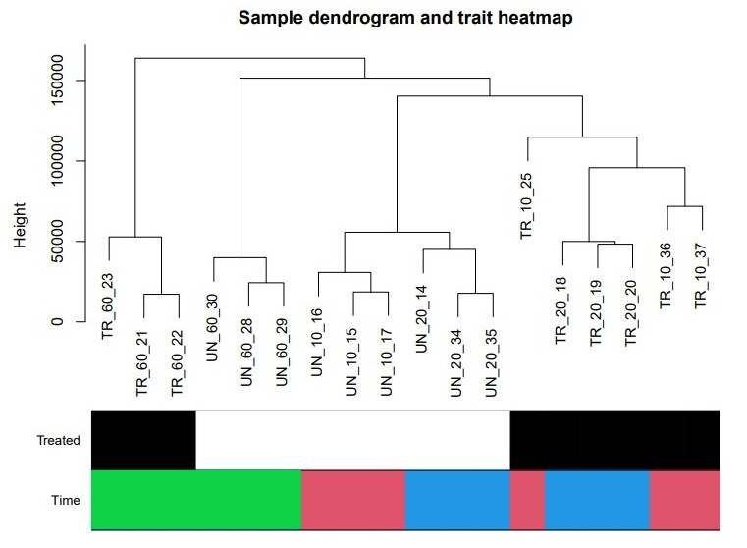
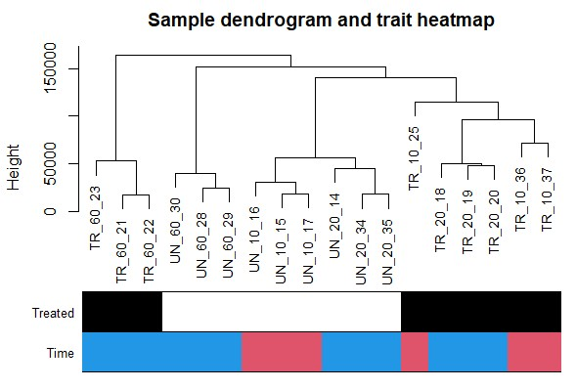
Samples clustering
The image shows hierarchical clustering of samples (two variables are highlighted: Treated: 0 - white, 1 - black; Time: 10 - pink, 20 - blue, 60 - green). Biological replicas are best grouped with each other, with the exception of sample 25. The processed samples at the time points of 10 and 20 minutes and the control samples at the same time points were grouped into two separate groups. The control and treated samples were separated into a separate group at 60 minutes. The data demonstrate an increase in the similarity of gene expression profiles of treated and untreated samples at 60 minutes.

Slide 14
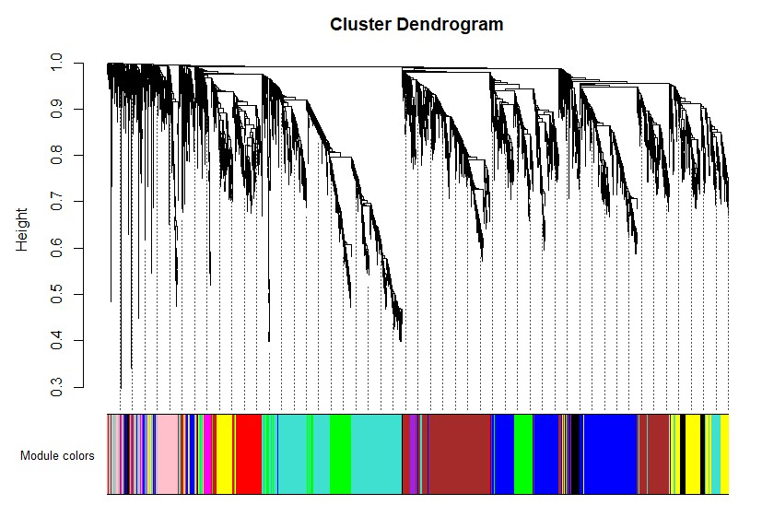
Modules building
Module-clustering dendrogram. After building the network, 10 connected modules and 1 zero module were defined. Number of genes in modules: 154, 056, 937, 927, 462, 425, 294, 179, 176, 72, 47.

Slide 15
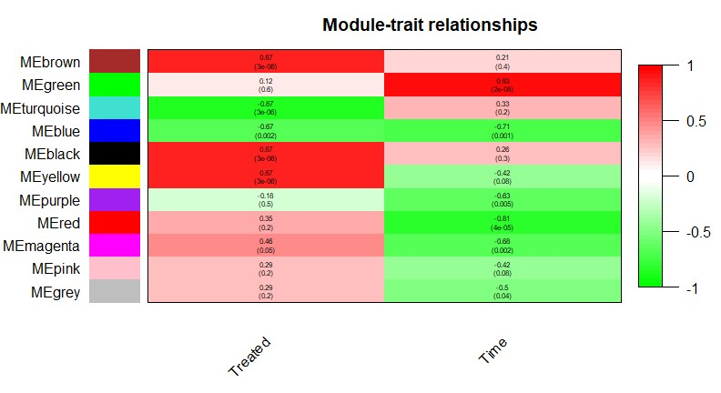
Modules associated with the “Treated” variable: brown, turquoise, black, yellow. Modules associated with the “Time” variable: green, blue, red.

Slide 16
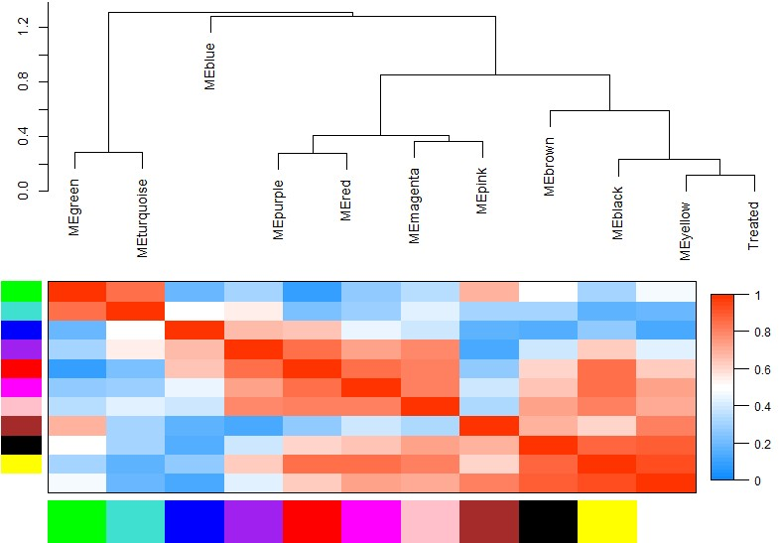
Modules clustering
Modules black, brown, yellow with a strong positive correlation with the “Treated” variable were combined into one group.

Slide 17
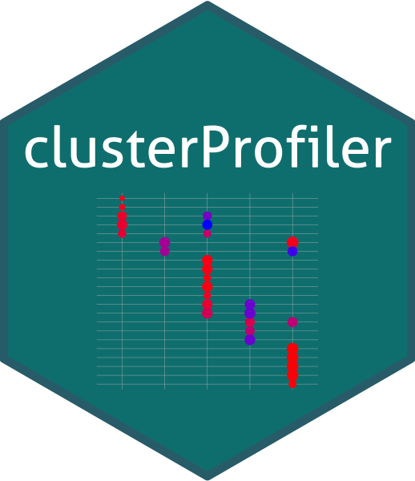
KEGG Enrichment Analysis
A custom Python script was used to process a list of gene names that belonged to the groups of positively differentiated expressed genes and negatively differentiated expressed genes.
ClusterProfiler version 4.2.2 was used to perform the KEGG enrichment analysis.
The significance threshold for pathways was chosen as 0.05.

Slide 18
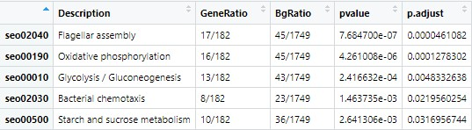
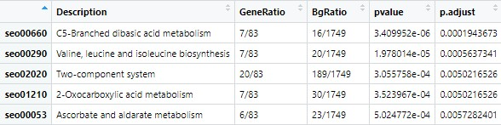
KEGG enrichment analysis for differentially expressed genes (DEGs)
Negative DEGs
Positive DEGs

Slide 19
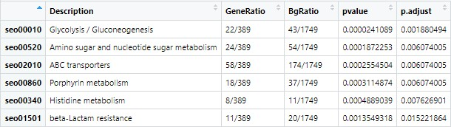
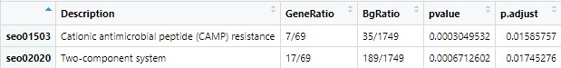
KEGG enrichment analysis for "Treated"-associated modules
Negative module
Positive modules

Slide 20
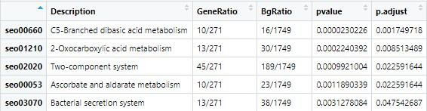
KEGG enrichment analysis for "Treated"-associated modules
Positive module
Several pathways were found in both the DESeq2 assay and the modules associated with novobiocin treatment:
C5-Branched dibasic acid metabolism;
2-Oxocarboxylic acid metabolism;
Two-component system;
Ascorbate and aldarate metabolism;
Glycolysis / Gluconeogenesis.

Slide 21
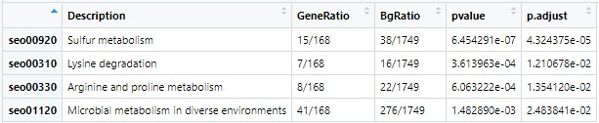
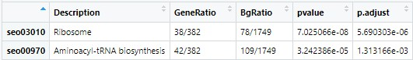
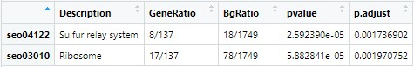
KEGG enrichment analysis for "Time"-associated modules
Positive module
Negative modules

Slide 22
Hub genes analysis
One of the key concepts of WGCNA is the concept of hub genes; hub genes are genes that have a large number of connections with other genes in the module [1]; such genes are most similar to the module's eigengene (first principal component) and they have the greatest relationship with the variable under study.
The functionality of the R language was used to identify the nodal genes in the module (nodal genes were considered to have a correlation coefficient with the eigengene of more than 0.9).
We obtained hub genes for modules associated with novobiocin and time.
Number of hub genes for different modules: black - 42; brown - 167; yellow - 108; turquoise - 284; red - 94; blue - 147; green - 160.

Slide 23
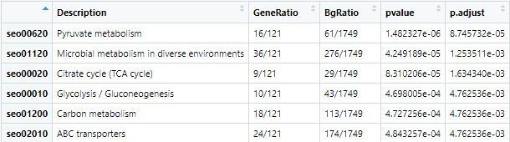
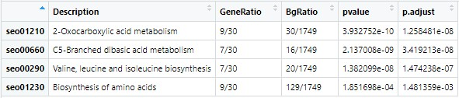
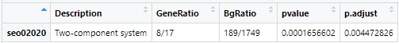
KEGG enrichment analysis for hub genes of modules associated with "Treated"
Hub genes from negative module
Hub genes from positive modules

Slide 24
KEGG enrichment analysis for hub genes of modules associated with "Treated"
Pathways were found that were consistently found both among the hub genes of the modules and among the differentially expressed genes:
C5-Branched dibasic acid metabolism;
2-Oxocarboxylic acid metabolism;
Two-component system;
Glycolysis / Gluconeogenesis.
These pathways are the most sensitive pathways to novobiocin treatment; they were used to visualize the dynamics of their expression.

Slide 25
Dynamics of changes in genes over time
The dynamics of changes in the expression of genes of various modules was visualized. The eigengene modules were used for visualization.
The x-axis of the graphs is time, the y-axis is the value of eigengene (the first principal component of the module)

Slide 26
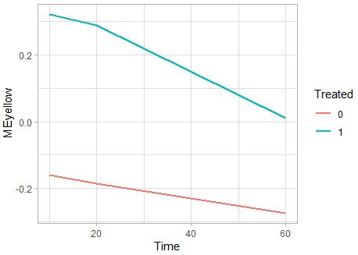
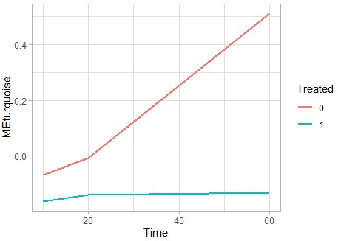
Modules "Treated". Positive module Yellow (left); negative Turquoise module (right)

Slide 27
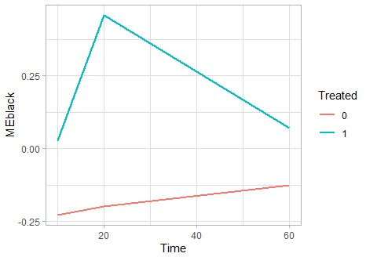
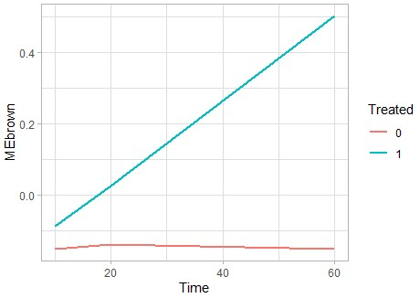
Modules "Treated". Positive modules Black (left) and Brown (right)

Slide 28
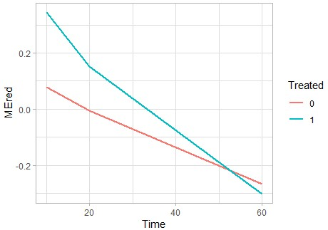
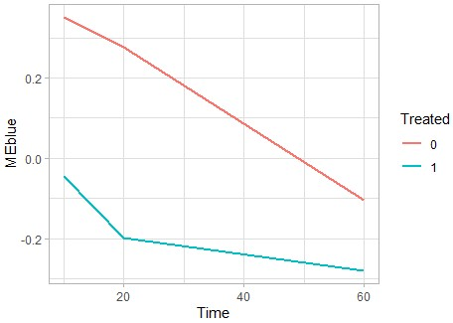
Positive modules associated with "Time"

Slide 29
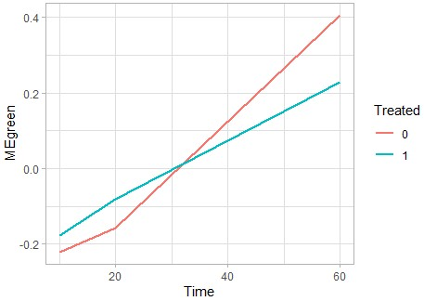
Negative module associated with "Time"

Slide 30
Analysis of the dynamics of significant pathways
The visualization of the dynamics of the hub genes pathways was carried out. As a generalization of gene expression, the first principal component was used for a subset of genes included in the module and included in a significant biological pathway.

Slide 31
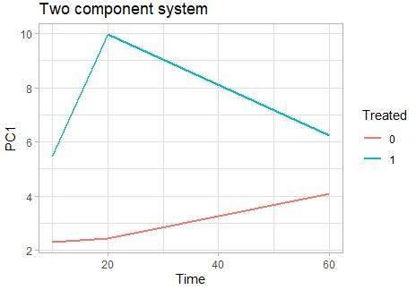
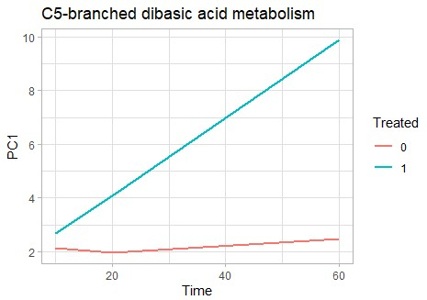
Analysis of the dynamics of significant pathways

Slide 32
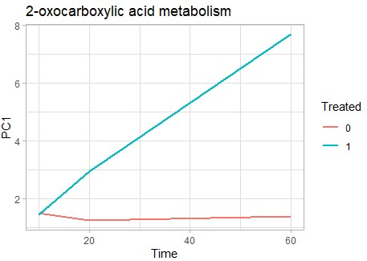
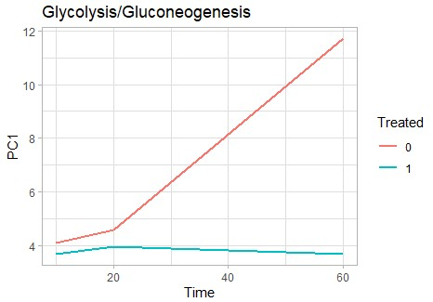
Analysis of the dynamics of significant pathways

Slide 33
Analysis of the dynamics of significant pathways
Biological pathways may have different dynamics over time; Two-component system genes increase their expression by 20 minutes with a subsequent decrease; C5-Branched dibasic acid metabolism and 2-Oxocarboxylic acid metabolism genes increase expression over time; Glycolysis/Gluconeogenesis genes increase their expression over time in control samples, however, when treated with novobiocin, they do not show any noticeable dynamics.
Two-component system is a system for perceiving changes in the environment [5]; this system can also be associated with a change in supercoiling, which also perceives a large number of stress stimuli (pH, osmotic composition, etc.) [6].
The lack of dynamics in the expression of glycolysis pathway genes may be associated with the bacteriostatic effect of novobiocin(these processes are associated with anabolic pathways); C5-Branched dibasic acid metabolism and 2-Oxocarboxylic acid metabolism may be involved in some of the signaling pathways associated with changes in supercoiling.

Slide 34
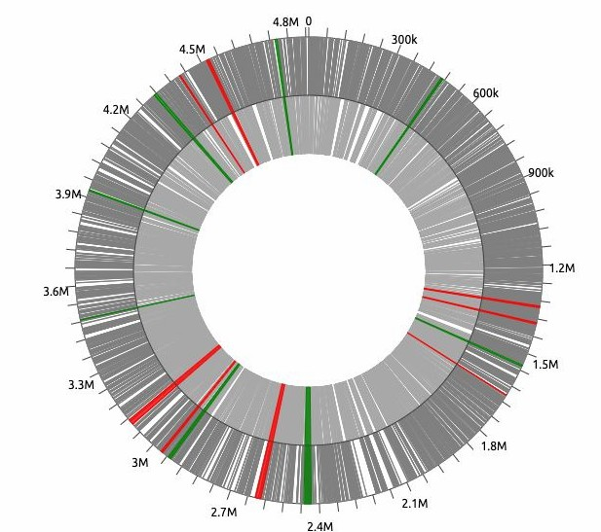
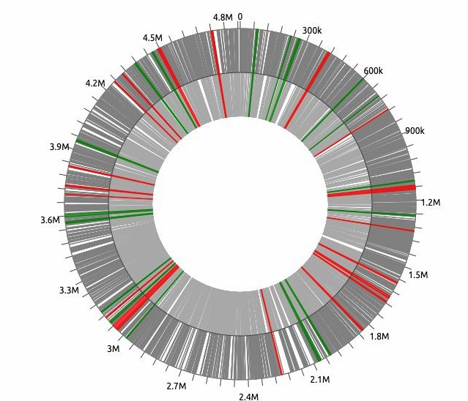
Mapping modules per chromosome
The modules associated with "Treated" and "Time" were mapped to the chromosome using the WoPPER online tool: https://wopper.ba.itb.cnr.it/WoPPER#!/View/v1nnzudodwda9keleutqqrw8znqo
“Time” modules
“Treated” modules

Slide 35
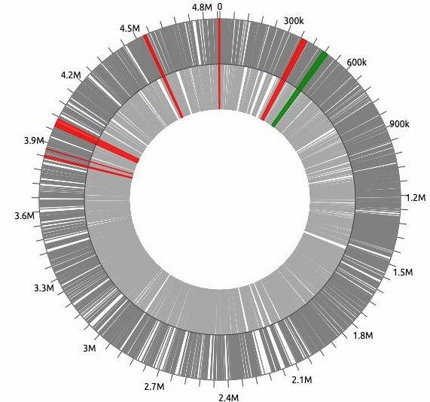
Mapping modules per chromosome
The co-expression modules show a diffuse distribution along the length of the chromosome, which may correspond to the influence of a systemic process, such as a change in supercoiling.
Genes in co-expressed modules are located at significant distances from each other (more than 1Mp). This can be explained by the topology of the chromosome, but does not exclude the influence of DNA supercoiling on the activation of modules.
"Treated" positive modules

Slide 36
AT-composition
The topological state of DNA influences its affinity for some DNA binding proteins, especially in DNA sequences that have a high A + T base content. For example, H-NS nucleoid-associated transcription-silencing protein has been described to bind to the region of A + T-rich DNA into the promoter Pleu-500 [3].
We compared the AT composition of the hub gene sequences associated with novobiocin treatment with the AT composition of the nodal genes associated with time.

Slide 37
AT-composition
The AT composition was calculated as the sum of A and T divided by the length of the sequence. This value was calculated for each gene from the list of hub genes. The results for the “Treated” and “Time” modules were combined. The distributions for the values were significantly different from normal (p-value = 2.2e-16 and p-value = 1.273e-12 for the "Treated" and "Time" modules, respectively), so the nonparametric Mann-Whitney test was used. The groups were significantly different from each other (p-value = 6.823e-11), although the difference between the means was small (0.496 and 0.470 for "Time" and "Treated", respectively).
The slight difference in the AT composition can be explained by the fact that it is important for supercoiling for the promoter regions of genes, so we studied it in the initial segments of the sequence using the sliding window method.

Slide 38
AT-composition
A "window" of 30 nucleotides long (the approximate length of a promoter) was iteratively shifted one nucleotide from the beginning of the gene sequence; The AT composition was calculated within the limits of the window according to the above method.
For each module, a sequence of values of the AT composition averaged for the hub genes of the module within the "window" is calculated.

Slide 39
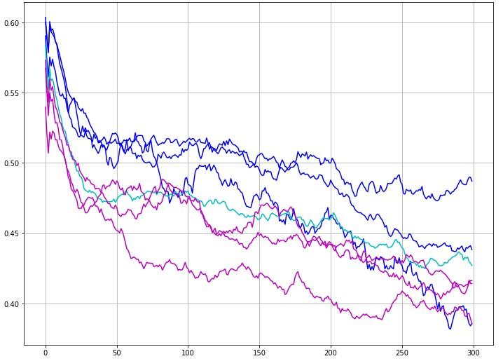
AT-composition
The graph shows the frequencies of A and T, calculated within a 30-nucleotide "window". The X-axis shows a section from 1 to 300 nucleotides of the gene under study. The Y-axis plots the average frequency of A and T (AT-composition) for the hub genes of the module in a given position of the "window". Blue shows the frequencies for modules that are positively correlated with the "Treated" variable; the module shown in blue is negatively correlated with the "Treated" variable; modules in purple are not correlated with the "Treated" variable (associated with the "Time" variable).

Slide 40
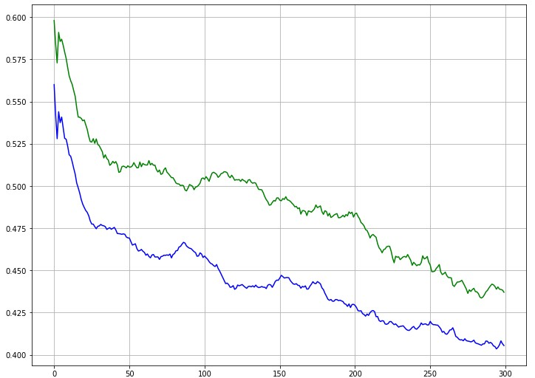
AT-composition
The negatively correlated module showed frequencies close to the "Time" modules, so we focused on the positive "Treated" modules. For positive modules "Treated" and for modules "Time" the values were averaged. Green indicates A and T frequencies for positive "Treated" modules, blue indicates frequencies for "Time" modules. The X and Y values correspond to the previous plot. Thus, the initial regions of genes sensitive to novobiocin are characterized by a richer AT composition, which suggests sensitivity to changes in DNA supercoiling.

Slide 41
Future plans
It has been shown that the antibiotic novobiocin can have effects unrelated to inhibition of DNA gyrase and changes in DNA twisting [4]. Thus, it would be interesting to clarify the results of the study. For example, find regulatory proteins for pathways found in modules associated with the action of novobiocin ("Treated" positive modules) and model their interaction with novobiocin. Among such proteins, special attention should be paid to those that have ATPase domains, since the interaction of novobiocin with similar domains in some proteins has been found [4].
For experimental verification, we propose a study of the action of novobiocin at other time points, for example, in later phases of cultivation. This will help clarify the dynamics of gene expression and identify new targets for novobiocin. Comparison of their position on the chromosome and AT composition will also be useful for clarifying the action of novobiocin and its relation to supercoiling.

Slide 42
Participant Contribution
Semyon Kupriyanov:
alignment of reads for reference
differential expression analysis with DESeq2
WGCN analysis (configuring network building parameters)
KEGG biological pathway enrichment assay
statistics on AT-composition
final presentation design
Valeriia Ladyhina:
obtaining a counting matrix of transcripts (StringTie)
getting a normalized matrix with DESeq2
WGCN analysis (use of other parameters for module stability)
mapping of genes from modules to a circular chromosome
assembly pipeline snakemake
designing a git repository

Slide 43
References
Zhang B., Horvath S. A general framework for weighted gene co-expression network analysis //Statistical applications in genetics and molecular biology. – 2005. – Т. 4. – №. 1.
Baranello L. et al. The importance of being supercoiled: how DNA mechanics regulate dynamic processes //Biochimica et Biophysica Acta (BBA)-Gene Regulatory Mechanisms. – 2012. – Т. 1819. – №. 7. – С. 632-638.
Dorman C. J., Dorman M. J. DNA supercoiling is a fundamental regulatory principle in the control of bacterial gene expression //Biophysical reviews. – 2016. – Т. 8. – №. 3. – С. 209-220.
May J. M. et al. The antibiotic novobiocin binds and activates the ATPase that powers lipopolysaccharide transport //Journal of the American Chemical Society. – 2017. – Т. 139. – №. 48. – С. 17221-17224.
Liu C. et al. Two-component signal transduction systems: a major strategy for connecting input stimuli to biofilm formation //Frontiers in Microbiology. – 2019. – С. 3279.
O'Byrne C. P., Bhriain N. N., Dorman C. J. The DNA supercoiling‐sensitive expression of the Salmonella typhimurium his operon requires the his attenuator and is modulated by anaerobiosis and by osmolarity //Molecular microbiology. – 1992. – Т. 6. – №. 17. – С. 2467-2476.

